Slide 1
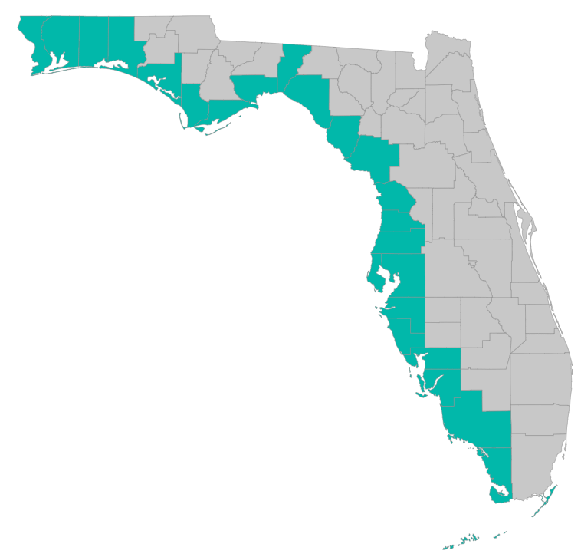
SEP Project Implementation – updates and Q&A
January 31, 2019 – Tallahassee, Florida

Slide 2
SEP Project Implementation info session agenda – Jan 31
Updates on progress
Grants Training Manual – Manatee County
Checklists, templates, guidance
https://www.gulfconsortium.org/grant-resources
Updates: cash drawdown projections; leveraged funding form
Environmental Compliance checklists – pre-award and post-award
Budgets
Indirect Costs, Direct Costs
Narrative
RESTORE Council – Jessica Henkel; Science Advisor and Coordinator
Q&A

Slide 3
Application Preparation – guidance
What is needed to submit a subaward application?
See guidance documents and templates at
https://www.gulfconsortium.org/grant-resources
Project Abstract
Project Narrative (BAS)
Budget Narrative
Budget Table SF 424
Milestone information
Metrics information (BAS)
Environmental Compliance Checklist (NEW)
Project Map
GIS shapefiles
Data Management Plan (BAS)
Observational Data Plan (BAS)
Cash Drawdown Projection and Leveraged Funding form (NEW)

Slide 4
Application Preparation – guidance
Environmental Compliance
Pre-award
Environmental Requirement | Has the requirement been addressed? | Compliance Notes (e.g., status of application, permit number, etc.)
Coastal Zone Management Act | ___ Yes ___ No ___ N/A
Coastal Barrier Resources Act | ___ Yes ___ No ___ N/A
Farmland Protection Policy Act | ___ Yes ___ No ___ N/A

Slide 5
Application Preparation – guidance
Environmental Compliance
Post-award
Environmental Requirement | Has the Requirement Been Addressed? | Compliance Notes (e.g., status of application, permit number, etc.)
Clean Water Act Section 404 | ___ Yes ___ No ___ N/A
River and Harbors Act Section 10 | ___ Yes ___ No ___ N/A
Marine Protection, Research and Sanctuaries Act | ___ Yes ___ No ___ N/A
Marine Mammal Protection Act | ___ Yes ___ No ___ N/A
National Marine Sanctuaries Act | ___ Yes ___ No ___ N/A
Migratory Bird Treaty Act | ___ Yes ___ No ___ N/A
Bald and Golden Eagle Protection Act | ___ Yes ___ No ___ N/A
Clean Air Act | ___ Yes ___ No ___ N/A
(Insert name of other applicable environmental law, as needed) | ___ Yes ___ No ___ N/A

Slide 6
Application Preparation – guidance
NEW
Template: “Cash Drawdown Projections and Leveraged Funds”
Spreadsheet to provide:
Cash drawdown estimates – how much money you expect to spend each 6 month period 10/1 to 3/31; 4/1 to 9/30… with beginning date as project start date
Leveraged funds form – if other funding is expected to complete a portion of the work, we want to know status, source, funding type and description, and amount

Slide 7
Application Preparation – guidance
Cash drawdown - projection
See template (NEW) https://www.gulfconsortium.org/grant-resources
“Cash drawdown and Leveraged Funding”

Slide 8
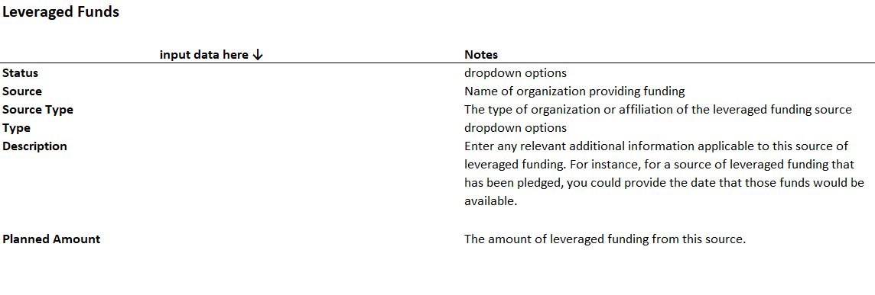
Application Preparation – guidance
Leveraged funding source information
See template (NEW) https://www.gulfconsortium.org/grant-resources
“Cash drawdown and Leveraged Funding”

Slide 9
Application Preparation – guidance
Budgets and Budget narratives
SF-424 a/c form (template on website)
Narrative – words matter! Need to be able to evaluate…
Allowability
Allocability
Reasonableness
Numbers need to match in budget and narrative
Indirect costs (facilities and administrative costs not readily assignable to a specific grant/project/objective)
Need to use rate from Negotiated Indirect Cost Rate Agreement (NICRA). If no NICRA, there is option of using a de minimis indirect cost rate of 10%.
Subrecipients NOT subject to 3% cap. Consortium is subject to 3% cap, but will be using direct costs where possible.

Slide 10
Application Preparation – guidance
How to submit a subaward application?
Online submittal form with attachments:
https://www.gulfconsortium.org/grant-resources
Attach all required documents as Word documents or spreadsheet or pdf map or zipped shapefiles (for GIS files)

Slide 11
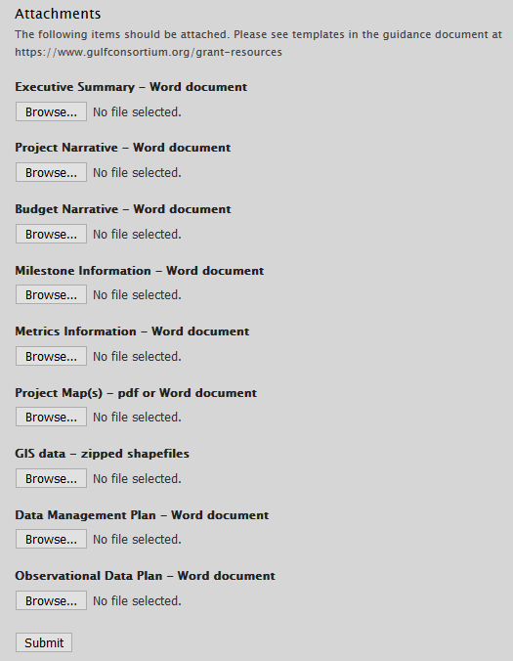
Application Preparation – guidance
How to submit a subaward application?

Slide 12
Application Preparation – guidance
Questions…
Contact:
Daniel Dourte
407.629.2185 ext. 113
ddourte@balmoralgroup.us

Slide 13
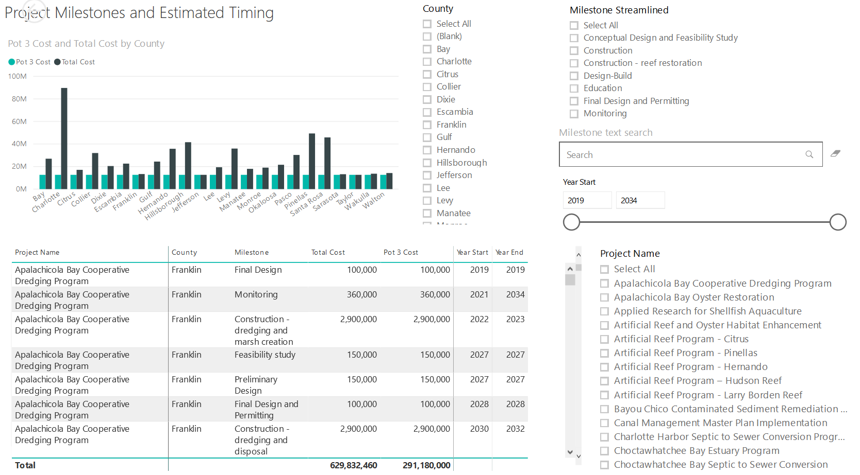
Application Preparation – Implementation Milestones and timing
Dashboard for Project Data
http://datavisual.balmoralgroup.us/GulfConsortiumProjects
milestones, start years, cost, goals, funding sources
GOAL:
Efficient, accurate grant application preparation
Interface for project details
Better, faster decisions on grant timing, readiness, bundling
Transparent tracking of progress and changes

