Slide 1
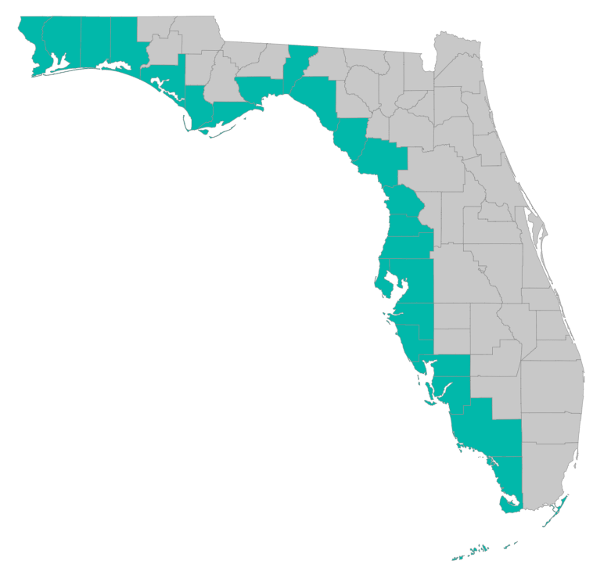
SEP Project Implementation – updates and Q&A
March 28, 2019 – GoToMeeting
Please join my meeting from your computer, tablet or smartphone. https://global.gotomeeting.com/join/785710869 You can also dial in using your phone. United States: +1 (312) 757-3119 Access Code: 785-710-869

Slide 2
SEP Project Implementation info session agenda
Checklists, templates, guidance
https://www.gulfconsortium.org/grant-resources
Environmental Compliance
Feedback from Council
Separating Council-funded portions of larger projects
Describing procurements – especially for continuing services
Explaining cost estimates
Dates: period of performance
Metrics – must have at least one for every application
What applications should proceed?
Where to apply? A NEW PLACE
Q&A

Slide 3
Application Preparation – guidance
What is needed to submit a subaward application?
See guidance documents and templates at
https://www.gulfconsortium.org/grant-resources
Project Abstract
Project Narrative (BAS)
Budget Narrative
Budget Table (SF 424 object class categories)
Milestone information
Metrics information (BAS)
Environmental Compliance Checklist
Project Map
GIS shapefiles
Data Management Plan (BAS)
Observational Data Plan (BAS)
Cash Drawdown Projection and Leveraged Funding form

Slide 4
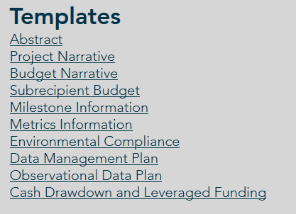
Application Preparation – guidance
What is needed to submit a subaward application?
https://www.gulfconsortium.org/grant-resources
Please use templates: more complete applications = less management cost
Save each of the blank templates; then save as project-specific name and fill them in

Slide 5
Application Preparation – guidance
Environmental Compliance
Environmental Requirement | Has the requirement been addressed? | Compliance Notes (e.g., status of application, permit number, etc.)
National Environmental Policy Act | ___ Yes ___ No ___ N/A
Endangered Species Act | ___ Yes ___ No ___ N/A
National Historic Preservation Act | ___ Yes ___ No ___ N/A
Magnuson-Stevens Act (Essential Fish Habitat) | ___ Yes ___ No ___ N/A
Fish and Wildlife Coordination Act | ___ Yes ___ No ___ N/A
Coastal Zone Management Act | ___ Yes ___ No ___ N/A
Coastal Barrier Resources Act | ___ Yes ___ No ___ N/A
Farmland Protection Policy Act | ___ Yes ___ No ___ N/A
Clean Water Act Section 404 | ___ Yes ___ No ___ N/A
Clean Water Act Section 401 | ___ Yes ___ No ___ N/A
River and Harbors Act Section 10 | ___ Yes ___ No ___ N/A
Marine Protection, Research and Sanctuaries Act | ___ Yes ___ No ___ N/A
Marine Mammal Protection Act | ___ Yes ___ No ___ N/A
National Marine Sanctuaries Act | ___ Yes ___ No ___ N/A
Migratory Bird Treaty Act | ___ Yes ___ No ___ N/A
Bald and Golden Eagle Protection Act | ___ Yes ___ No ___ N/A
Clean Air Act | ___ Yes ___ No ___ N/A

Slide 6
Environmental Compliance
“For activities that involve only planning (with no implementation funding), the sponsor should normally check “N/A” for the laws listed below. However, there may be instances where a component of a planning activity may trigger one or more laws,
For example engineering and design including geotechnical boring or sampling – may require a CWA Section 404 permit.”
Interagency group was established to ensure Environmental Compliance is handled efficiently:
Gulf Consortium, RESTORE Council, NOAA (NMFS), USACE (several district and local offices), LA CPRA, EPA, USFWS, and FDEP
Pre-application meetings strongly encouraged: to help influence design in ways that ease permitting process

Slide 7
Environmental Compliance
Environmental Compliance review matrix (from Council):
"CWA Sect 404 Required? Y/N/M"
"R&H Sect 10 Permit Required? Y/N/M"
USACE application/permit no.
"Has USACE permit been issued? Y/N"
Relevant NEPA analysis
CZMA
State appl/permit no.
CWA 401 WQ
"ESA NMFS Y/N/M/ NA/Notes"
"ESA FWS Y/N/M/ NA/Notes"
NHPA
MSA EFH
FWCA
CBRA Unit? Exemption Needed? Notes
MMPA
MBTA
BGEPA
Other (FLPA, MPRSA, CAA)
"Other USACE Auth. Required?(408, GIWW, CW projects etc)"
EJ concern?
1. Your consultant should know whether these apply, based on the scope of work you intend and the location
2. Identify challenges or considerations, such as work close to a navigation channel, or work that will impact a specific environmental resource
3. Will not release funds until all compliance is demonstrated

Slide 8
Environmental Compliance
Importance of location:
Coastal Barrier Resources Act units
Connection to Waters of the U.S./tidally influenced
If you don’t know, your concept design or environmental science consultant should have identified this information
Reference their study as the source of your information (i.e. “per JEA 2017 study, Phase I location is considered not hydrologically connected to WOTUS and should not trigger relevant permits”)

Slide 9
Environmental Compliance
Not sure?
Check with us with any questions, or:
Setup discussions with your consultants to be sure design is planned with successful permitting in mind before you start work – directional drilling, for example, rather than trenches
Pre-application meetings strongly encouraged
May be able to identify revisions you can make to achieve programmatic biological opinion or address concurrences
Avoids individual permit, which costs time and $
Can identify when certain data needs to be collected to avoid project delays
Seagrass surveys, for example: June - September

Slide 10
Separation of effort, milestones, funds
Council needs to see what exactly the Pot 3 funds will accomplish
“we can’t pay for half a bridge”
Need narrative to provide some separation (geographic or % complete or other) between what leverage funds achieve and what Pot 3 funds achieve
If we can’t separate, we have to call it “co-funded” and then we have to track and report on all the funding sources (more admin $)

Slide 11
Observational Data Plan
Every application needs a metric
https://www.gulfconsortium.org/grant-resources

Slide 12
Observational Data Plan
Sample planning project metric and supporting data:
Metric: PRM001 - # studies/models used to inform management
Metric PRM001 Success Criteria: 2 reports compiled in support of technical design, environmental compliance, and monitoring
Measure I: Data Collection Report
Success Criteria Parameter I: Completion of a data collection report to support preliminary and final project design. The final data collection report may include, but is not limited to, the following sub-reports: bathymetric, topographic, and magnetometer survey reports, and geotechnical reports.
Measure II: Preliminary Design Report
Success Criteria Parameter I: Completion of a preliminary design report and draft 30% set of project plans to support permit application and present recommended project features, surveys, location of borings, cost estimates, and draft adaptive management and monitoring plan.

Slide 13
Observational Data Plan
What if we don’t meet the numeric success criteria we used for a metric?
Just explain why
Opportunity for adaptive management
No financial consequences (assuming work was actually implemented)
Metric choice
Start with “Metrics suggestions and new metrics” spreadsheet at https://www.gulfconsortium.org/grant-resources

Slide 14
Period of Performance
The time between “Project Start Date” and “Project End Date”
… from Council guidance
Project Start Date: The anticipated start date of proposed activities. This is the date the applicant wants the award term to start.
Project End Date: The anticipated end date of proposed activities. This is the date that the applicant wants the award term to end.
Hint: When entering the Start and End dates, try to set dates that are realistic. Remember to provide sufficient time for the Council staff to review the application and process the award, for any applicable contracts to be negotiated, and for the entire project or program scope of work, including any close out activities, to be completed.

Slide 15
Period of Performance
What to do if you want to start work (with allowable costs) right away (before Council says yes to an award):
… from Council guidance
If there is additional funding (2 options):
Separate the Pot 3 funded portion into a distinct deliverable that follows deliverables completed with other funds (E&D – 50% complete plans; or dredging 500,000 cu. yd. in NW portion of lake)
Prepare a pre-award letter (how much $, when it starts, reason it starts right away, what the $ is for); also need a subrecipient agreement for this to work (between County and Consortium)
If there is NOT additional funding (2 options):
Wait until award
Prepare a pre-award letter – with help of Consortium staff

Slide 16
Application Preparation – upcoming applications
Next suggested date to submit applications by: 4/26/2019
Don’t need to wait until then – submit whenever you’re ready
What portions of projects can proceed? Anything with a 2019 or 2020 start date in the SEP… see http://datavisual.balmoralgroup.us/GulfConsortiumProjects and ask us for help or suggestions

Slide 17
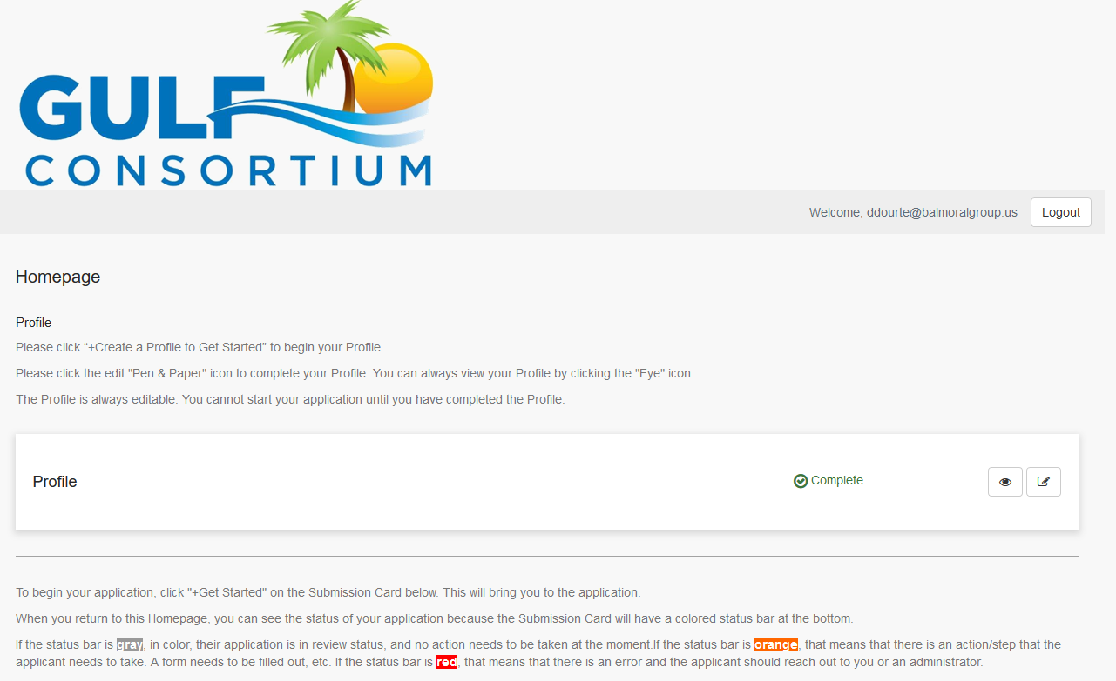
Application Preparation – upcoming applications
How to submit a subaward application? NEW grants mgmt. system
https://webportalapp.com/sp/gulfconsortium_sep_projects

Slide 18
Application Preparation – upcoming applications
Why a grants mgmt. system?
Ensure consistent tracking of project progress and spending
30+ active awards, twice-annual reporting, incoming applications, payment requests… a lot to look after in email boxes
Ensure Council that we have systems in place to efficiently manage projects
If it saves us a little more than an hour a week it pays for itself ($9.5k annual cost)
https://webportalapp.com/sp/gulfconsortium_sep_projects

Slide 19
Application Preparation – upcoming applications
How to submit a subaward application? NEW grants mgmt. system
Make a profile
Add an application
Fill out and submit an application
Use templates locally or on your servers to make complete application attachments before submittal (budget, budget narrative, etc.)
https://webportalapp.com/sp/gulfconsortium_sep_projects

Slide 20
Application Preparation – upcoming applications
How to submit a subaward application? NEW grants mgmt. system
https://webportalapp.com/sp/gulfconsortium_sep_projects

Slide 21
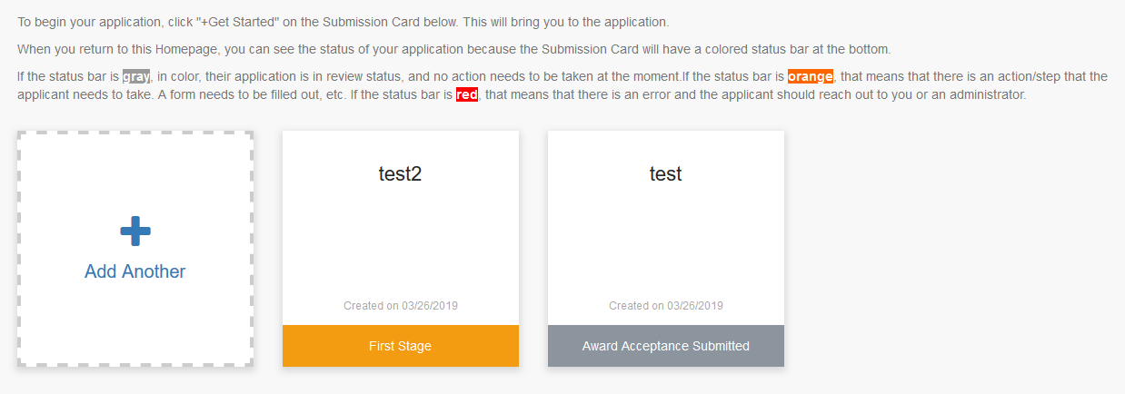
Application Preparation – upcoming applications
How to submit a subaward application? NEW grants mgmt. system
https://webportalapp.com/sp/gulfconsortium_sep_projects
On homepage, can always see status of all applications associated with your profile

Slide 22
Application Preparation – guidance
Questions…
Contact:
Daniel Dourte
407.629.2185 ext. 113
ddourte@balmoralgroup.us

Slide 23
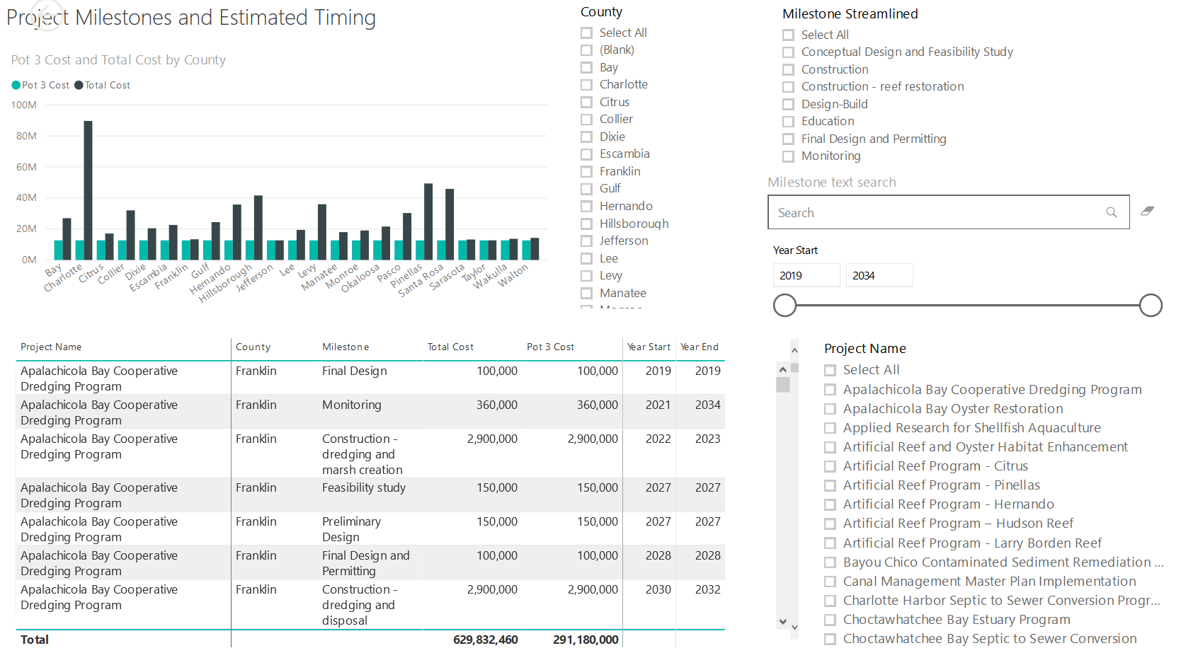
Application Preparation – Implementation Milestones and timing
Dashboard for Project Data
http://datavisual.balmoralgroup.us/GulfConsortiumProjects
milestones, start years, cost, goals, funding sources
GOAL:
Efficient, accurate grant application preparation
Interface for project details
Better, faster decisions on grant timing, readiness, bundling
Transparent tracking of progress and changes

